Slide 1
DATA VISUALIZATION: HAPPINESS FACTORS
Interactive Visualization Software Design

Slide 2

World Happiness Report
The World Happiness Report is a landmark survey of the state of global happiness.. The World Happiness ranks approximately 150 countries by their happiness levels. The report continues to gain global recognition as governments, organizations and civil society increasingly use happiness indicators to inform their policy-making decisions. Leading experts across fields – economics, psychology, survey analysis, national statistics, health, public policy and more – describe how measurements of well-being can be used effectively to assess the progress of nations. The reports review the state of happiness in the world today and show how the new science of happiness explains personal and national variations in happiness.

Slide 3
World Happiness Report
The happiness scores and rankings use data from the Gallup World Poll. The scores are based on answers to the main life evaluation question asked in the poll. This question asks respondents to think of a ladder with the best possible life for them being a 10 and the worst possible life being a 0 and to rate their own current lives on that scale. The columns following the happiness score estimate the extent to which each of six factors – economic production, social support, life expectancy, freedom, absence of corruption, and generosity – contribute to making life evaluations higher in each country than they are in Dystopia, a hypothetical country that has values equal to the world’s lowest national averages for each of the six factors. They have no impact on the total score reported for each country, but they do explain why some countries rank higher than others.

Slide 4
THE 6 HAPPINESS FACTORS
—ECONOMIC PRODUCTION
—SOCIAL SUPPORT
—LIFE EXPECTANCY
—FREEDOM
—NO CORRUPTION
—GENEROSITY
“It increases productivity, predicts income and affects labor market performance”
“People who perceive their family and friends as supportive report greater happiness”
“Being happy may be associated with better health and longevity”
“Psychological freedom is most strongly related to happiness in rich nations”
“Perceived corruption has a significant negative effect on happiness”
“Giving to others, they say, activates an area of the brain linked with contentment and the reward cycle”

Slide 5
QUESTION TO ASK
WHAT MAKES PEOPLE IN A COUNTRY HAPPY?

Slide 6
QUESTION TO ASK
HOW DOES EACH FACTOR RELATE TO EACH OTHER?

Slide 7
OUR PROCESS
MARS
SATURN
DAY 02
DAY 04
DAY 01
DAY 03
JUPITER
NEPTUNE
Despite being red, Mars is a cold place
Saturn is composed of hydrogen and helium
It’s the biggest planet in the Solar System
It’s the farthest planet from the Sun

Slide 8
Features & Task
01
02
03
INTERFACE MENU
SCATTER PLOT
GLOBAL ANALYSIS
Allows dropdown menus and buttons to change visualization
Allows users to select different happiness factors
Present a global view of happiness rank

Slide 9
GLOBAL MAP ANALYSIS
HAPPIESNT COUNTRY
7.769
7.6
7.554
Finland
Denmark
Norway

Slide 10
GLOBAL MAP ANALYSIS
DESIGN CONCEPT
The design of the global map is to present users a comprehensive overview of happiness level in each country.
I will use a choropleth map with legend in which a set of pre-defined areas is colored or patterned in proportion to a statistical variable that represents an aggregate summary of a geographic characteristic within each area.
I will implement a hover function that allows users to view each country’s ranking and happiness score.

Slide 11
Interactive Scatter Plot
DESIGN CONCEPT
The design of the interactive scatter plot is to allow users to views multiple views of different happiness factors for comparison.
I will implement a dropdown menus allow users to select the factors they want to view.
They can see correlation between the level of happiness and each of the six happiness factors.
In addition, users can select two different happiness factors to examine any correlation.
When users select a new variables, the scatter points will move interactively within the plot

Slide 12
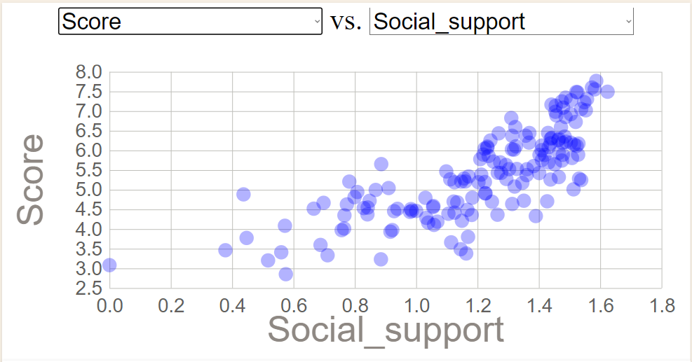
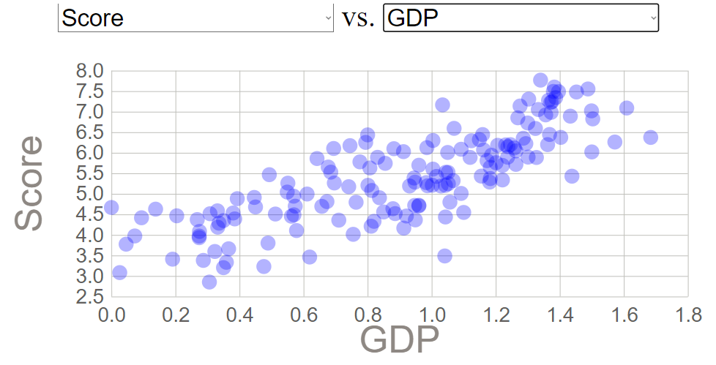
Interactive Scatter Plot

Slide 13
Interface
Both the choropleth map and scatter plots are viewable with selection buttons. Users can switch from map to scatter plot and vice versa so they are provided a comprehensive overview of the information.

